Slide 1
Washington county house sales dashboard
File created on: 5/3/2024 4:46:32 AM

Slide 2
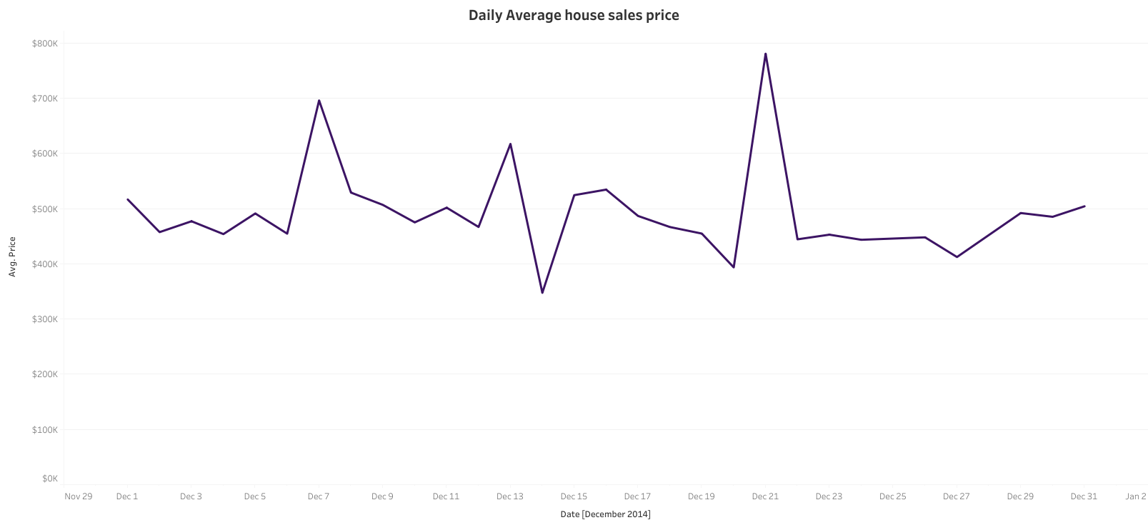

Slide 3
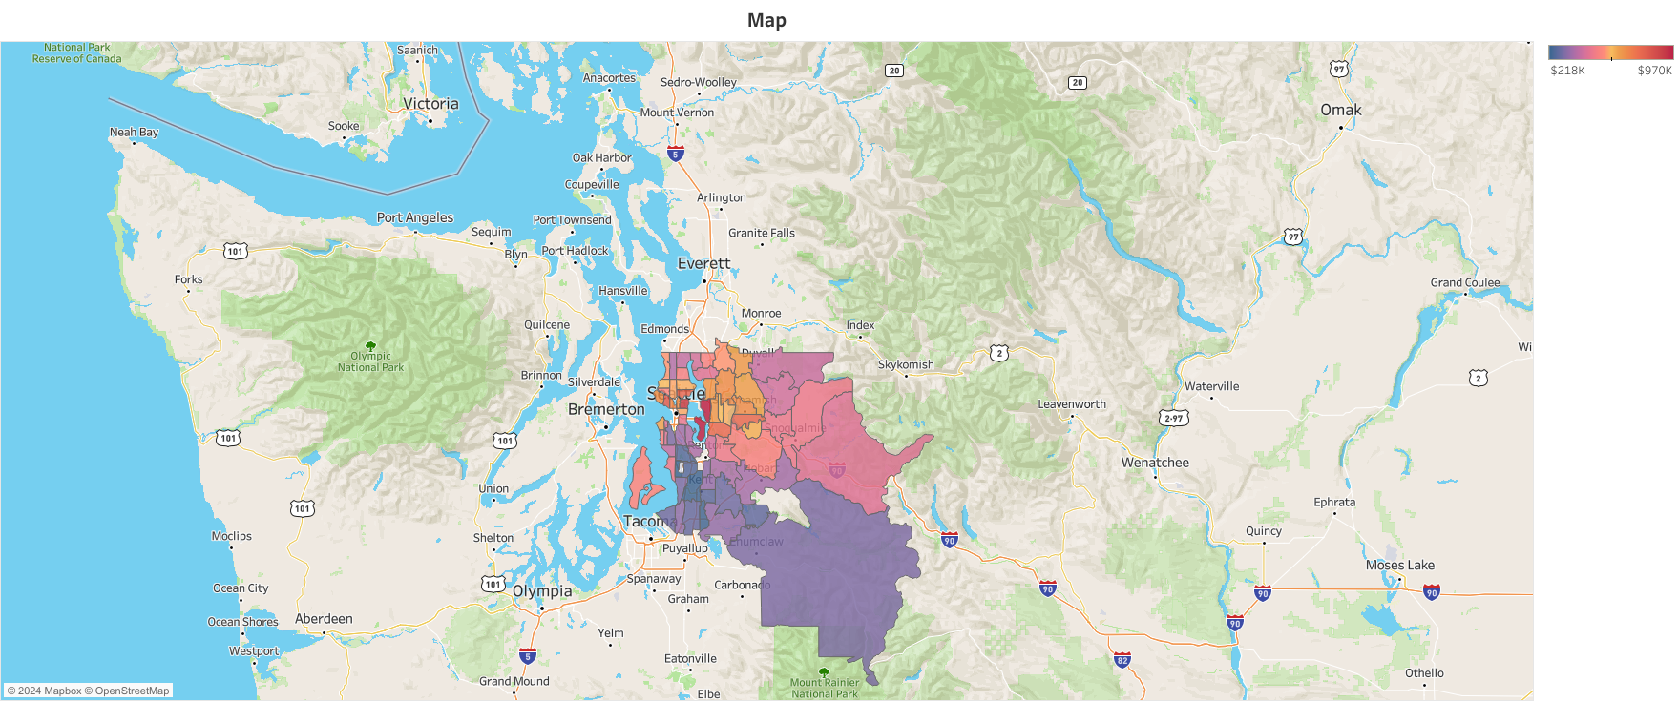

Slide 4
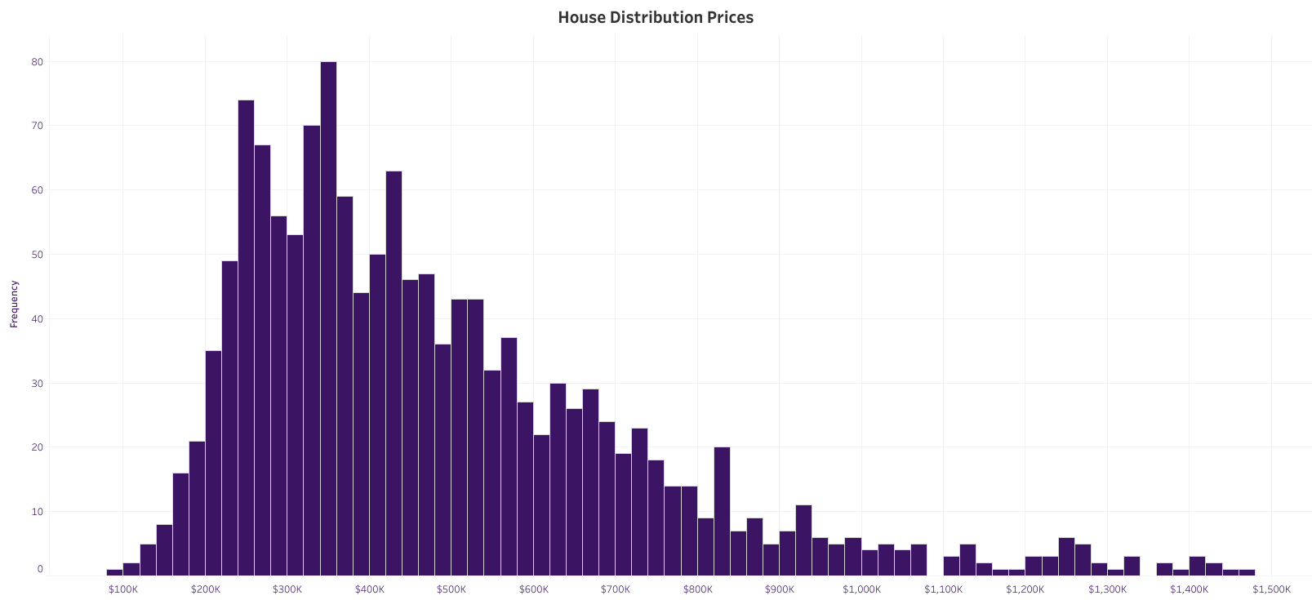

Slide 5
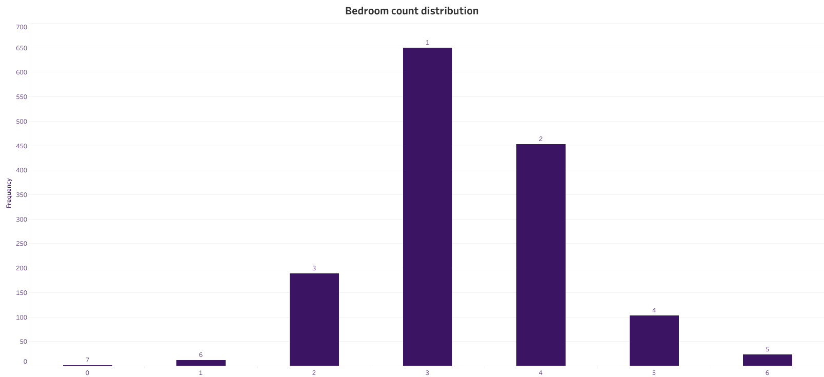

Slide 6
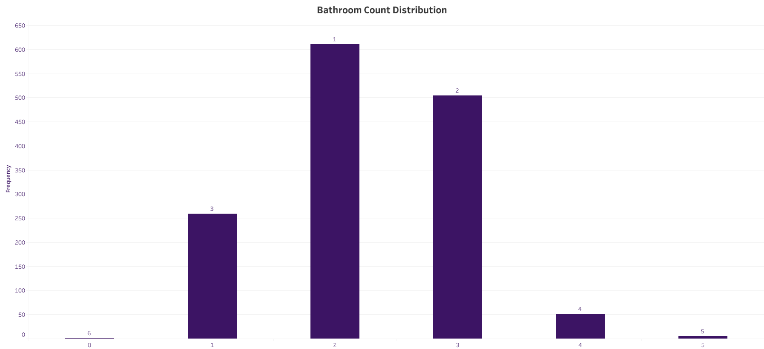

Slide 7


Slide 8


Slide 9
